Slide 1
Beyond Backpropagation: Uncertainty Propagation
NEIL LAWRENCE
UNIVERSITY OF SHEFFIELD
@lawrennd
Notes:
Challenges
Introduce self
Alphago impressive but requires heavy compute.
More games of go than any human
And yet still Lee managed to win a match.

Slide 2
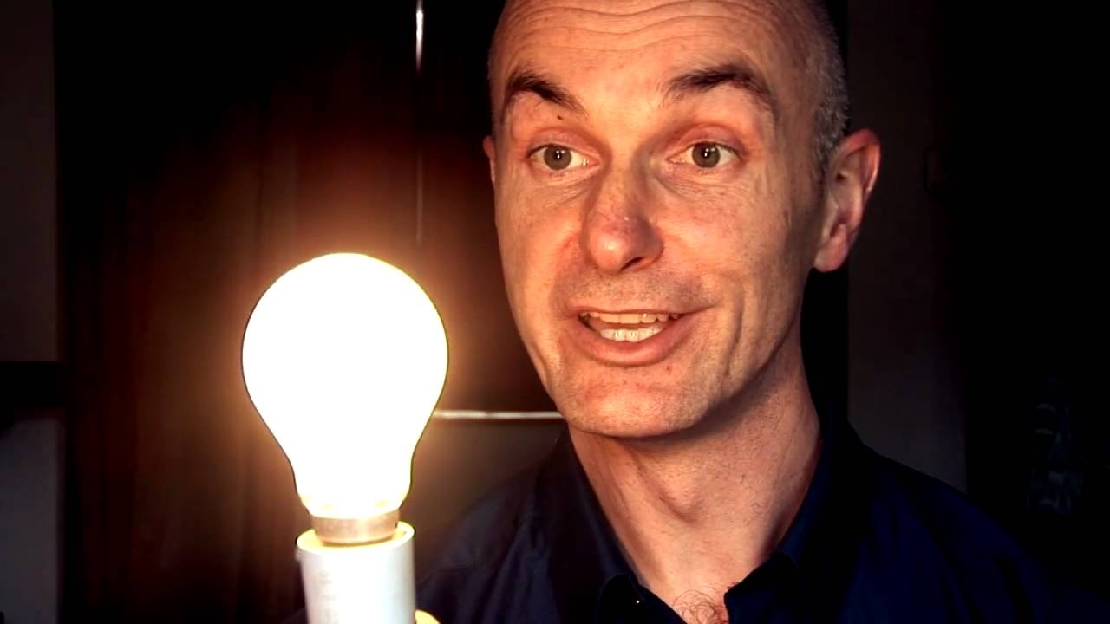

Slide 3

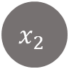








$$f\left(x\right)=\sum_{j=1}^{k}{u_{j}φ\left(a_{j}\right)}$$
$$x_{1}$$
$$x_{2}$$
$$x_{p}$$
$$a_{1}$$
$$a_{2}$$
$$a_{3}$$
$$a_{k}$$
$$a_{j}=\sum_{i=1}^{p}{v_{i,j}}x_{i}$$
$$f$$

Slide 4




$$x_{1}$$
$$x_{2}$$
$$x_{p}$$
$$v_{i,j}\sim N\left(0,α_{u}\right)$$
$$a_{1}$$
$$a_{2}$$
$$a_{3}$$
$$a_{k}$$
$$u_{i}\sim N\left(0,α_{u}\right)$$
$$f$$
$$E\left(u,V\right)=\sum_{i=1}^{n}{{\left(y_{i}−f\left(x_{i};u, V\right)\right)}^{2}}$$
$$\log{p\left(y | x,u,V\right)= }\frac{1}{2σ^{2}}\sum_{i=1}^{n}{{\left(y_{i}−f\left(x_{i};u, V\right)\right)}^{2}}−\frac{n}{2}\log{2πσ^{2}}$$

Slide 5


$$\log{p\left(y | x,u,V\right)= }\frac{1}{2σ^{2}}\sum_{i=1}^{n}{{\left(y_{i}−f\left(x_{i};u, V\right)\right)}^{2}}−\frac{1}{2α_{u}}u_{i}^{2}−\frac{1}{2α_{v}}v_{i,j}^{2}$$
$$+ const.$$

Slide 6
GLOBAL INFORMATION STORAGE CAPACITY IN OPTIMALLY COMPRESSED BYTES
SVMs
dominate
NIPS
ConvNets
Developed
Notes:
Superhuman performances are being driven by ML
Vision, Speech, Translation
Lots of process, but driven by availability of data.
Methodologies have not progressed a great deal since late 1990s

Slide 7






Zero Mean Gaussian Sample
Zero Mean Gaussian Process Sample
index
$$t^{′}$$
5
10
15
20
25
2
1
0.9
1.5
5
0.8
0.7
1
$$y(t)$$
10
0.6
$$\text{y}$$
index
$$t$$
0.5
0.5
15
0.4
0.3
0
20
0.2
0.1
25
0
5
10
15
20
25
index
t
covariance $\text{C}$
covariance function $c(t,t^{′})$
samples from Gaussian
samples from Gaussian process

Slide 8






Gaussian Processes
$$x_{1},y_{1}$$
$${x_{2},y}_{2}$$
$$p\left(f | x\right)$$
$$p\left(y_{1}|f_{1}\right)$$
$$p\left(f|y,x\right)$$
$$p\left(y_{2}|f_{2}\right)$$

Slide 9

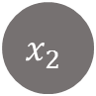








$$x_{1}$$
$$x_{2}$$
$$x_{p}$$
$$v_{i,j}\sim ?$$
$$a_{1}$$
$$a_{2}$$
$$a_{3}$$
$$a_{k}$$
$$u_{i}\sim N\left(0,α_{u}\right)$$
$$f$$

Slide 10
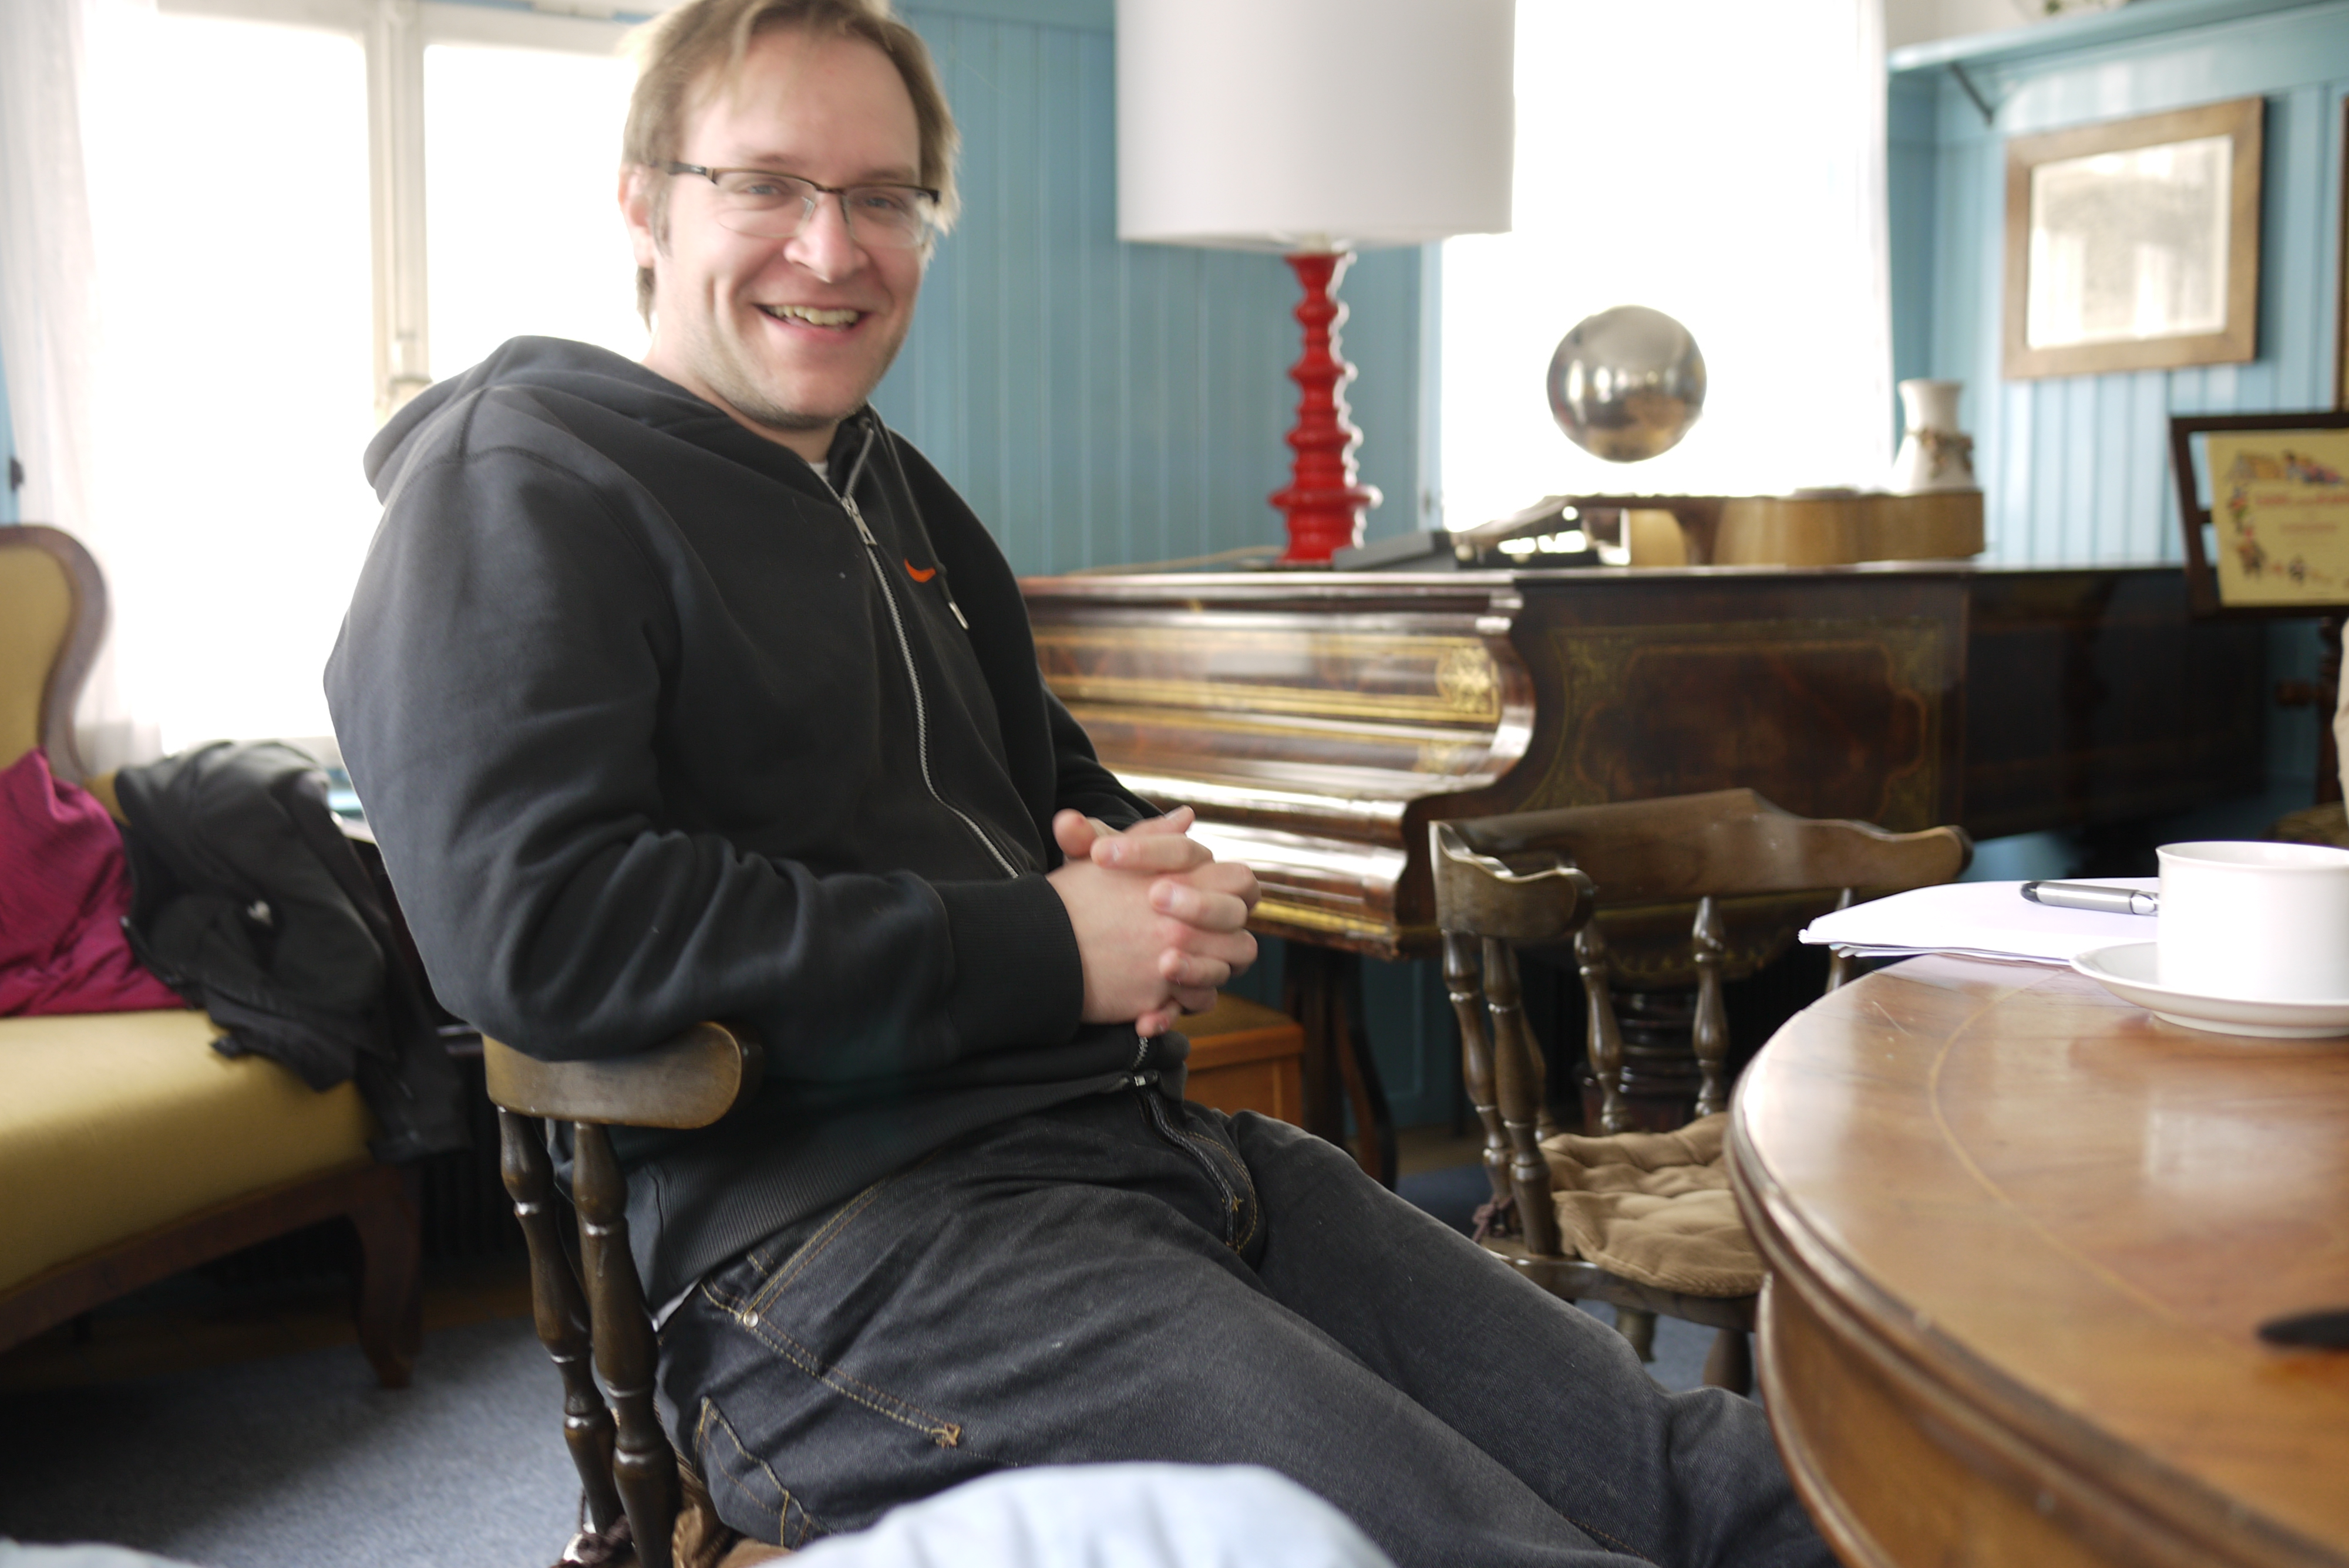
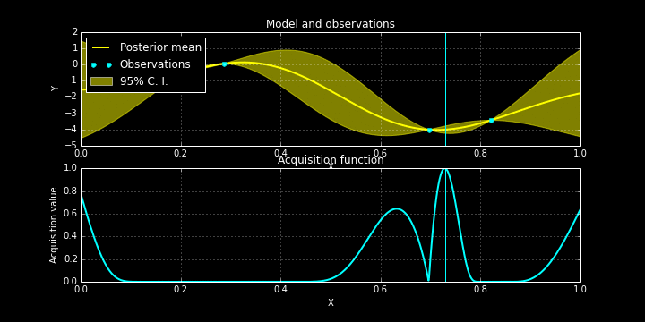
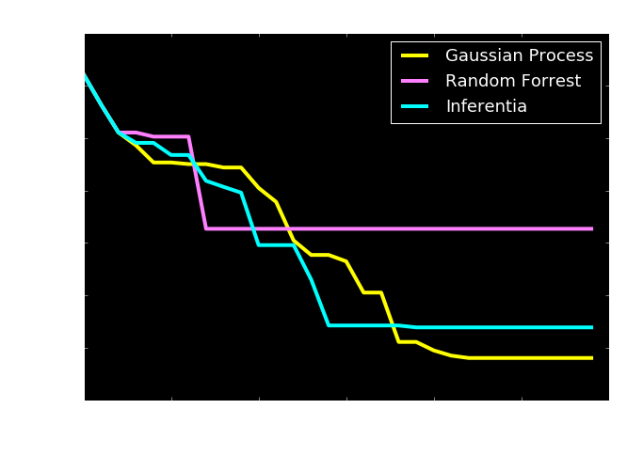
Bayesian Optimization
Check http://sheffieldml.github.io/GPyOpt/

Slide 11
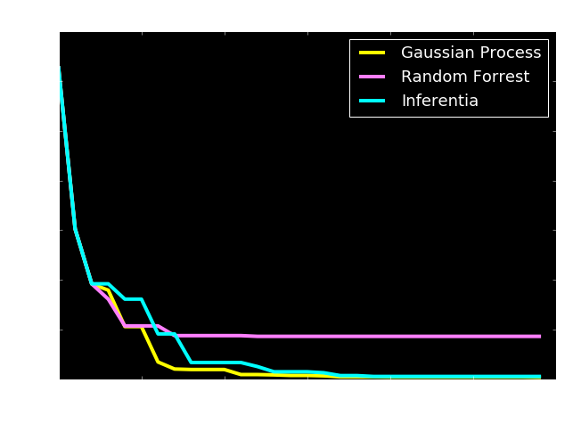
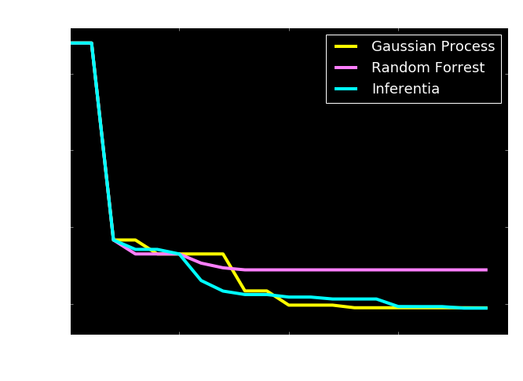
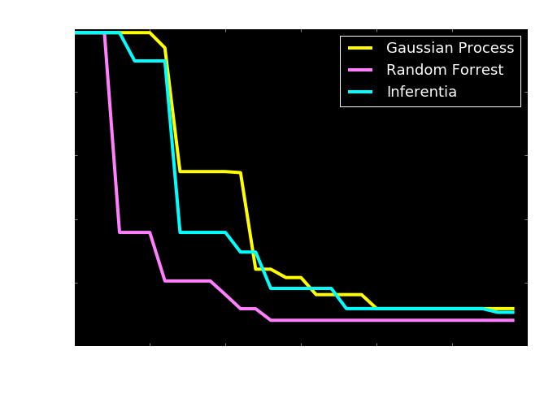
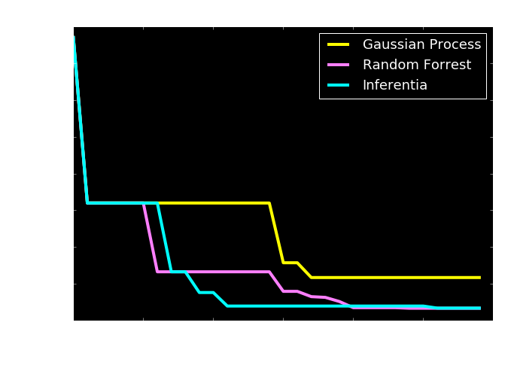

Slide 12
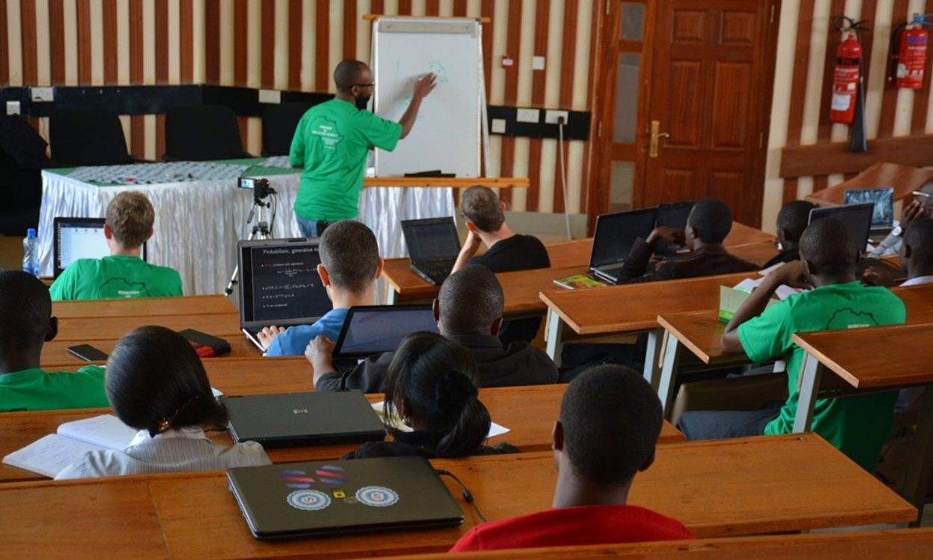
Open Data Science and Africa
Challenge
“Whole pipeline challenge”
Make software available
Teach summer schools
Support local meetings
Publicity in the Guardian
Opportunities to deploy pipeline solutions
Notes:
Talk about why Africa is an interesting domain for deploying machine learning models, particularly given the context of the lack of infrastructure there and the possiblities for deploying solutions that are actually more efficient than those we have in Europe. The need to work with systems designers and cryptographers.
Uncertainty and modelling often critical in resource limited environments when a proper statistical design can not be undertaken due to cost.

Slide 13
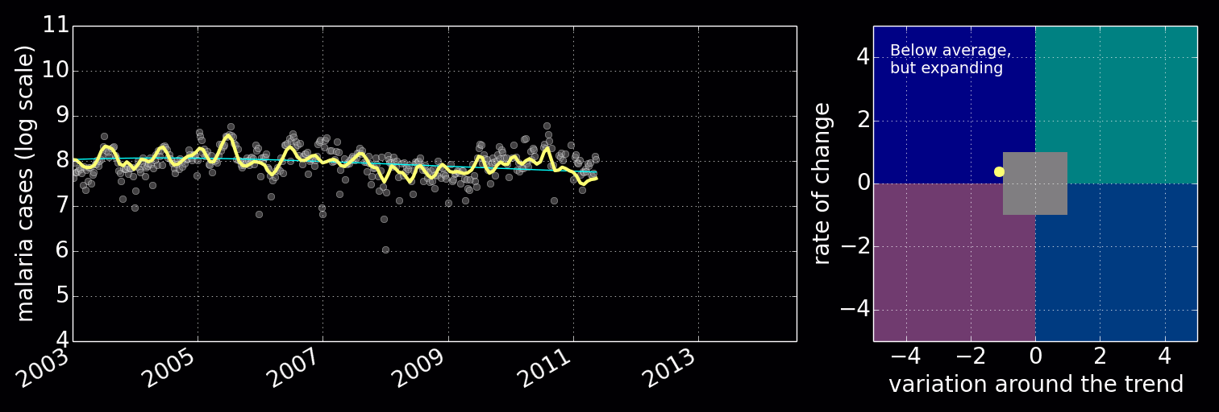
Disease Incidence for Malaria
Notes:
Here I’ll use the example of disease monitoring in Uganda to describe the utility of these models in practice. I’ll relate what we need to do in resource deprived environments with a classical epidemiological approach (which would involve a randomized survey). The importance of modelling becomes apparent when the data itself is not randomized.

Slide 14
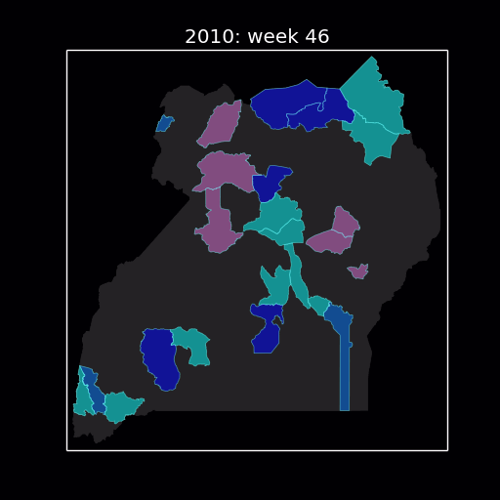
Uganda
Spatial models of disease
Notes:
Here I’ll use the example of disease monitoring in Uganda to describe the utility of these models in practice. I’ll relate what we need to do in resource deprived environments with a classical epidemiological approach (which would involve a randomized survey). The importance of modelling becomes apparent when the data itself is not randomized.

Slide 15
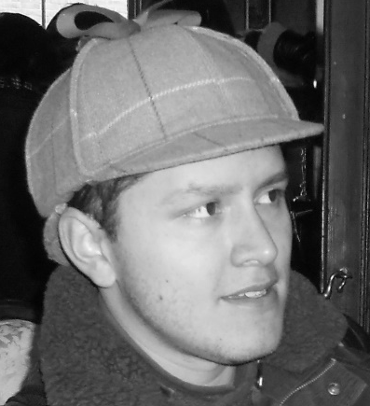
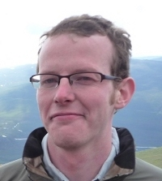

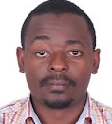
Deployed with UN Global Pulse Lab
http://pulselabkampala.ug/hmis/
Notes:
Possibly show a quick demo of the site Ricardo worked on with UN global pulse.

Slide 16
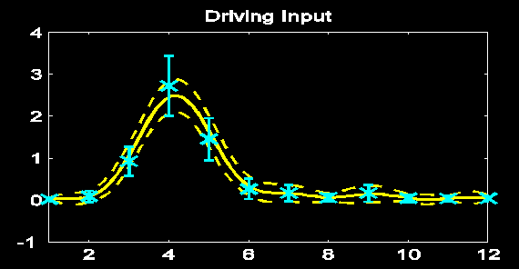
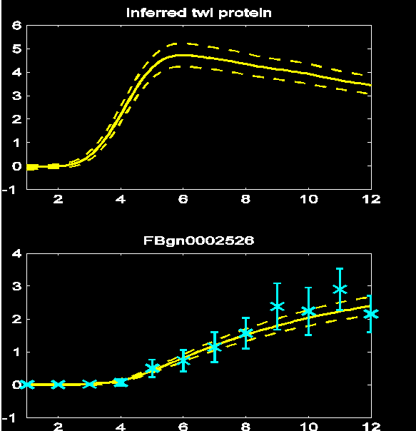


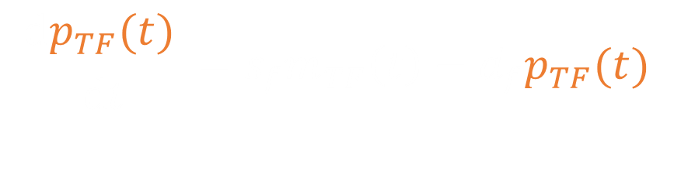

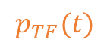
Results
$$m_{TF}\left(t\right)$$
$$\frac{ⅆp_{TF}(t) }{ⅆt}=s_{f}m_{TF}\left(t\right)−d_{f}p_{TF}(t)$$
$$p_{TF}(t)$$
$$\frac{ⅆm_{i}(t)}{ⅆt}=s_{i}p_{TF}(t)−d_{i}m_{i}(t)$$
$$m_{i}(t)$$
TPAMI, 2 PNAS papers, 2 Comp Bio

Slide 17
David: Have we thrown out the baby with the bathwater?

Slide 18











$\text{g}\left(x\right)$
${\text{f}}_{1}(x)$
${\text{f}}_{2}(∙)$
${\text{f}}_{3}(∙)$
${\text{f}}_{4}(∙)$
${\text{f}}_{5}(∙)$
${\text{f}}_{6}(∙)$
${\text{f}}_{7}(∙)$
${\text{f}}_{8}(∙)$
${\text{f}}_{9}(∙)$
$\text{g}\left(x\right)={\text{f}}_{9}\left({\text{f}}_{8}\left({\text{f}}_{7}\left({\text{f}}_{6}\left(⋯\right)\right)\right)\right)$

Slide 19


$$p\left(y,w | x\right)=p\left(y | w,x\right)p\left(w\right)$$
$$x$$
w
y
$$p\left(y|x\right)=∫p\left(y | w,x\right)p(w)dw$$

Slide 20





$$\log{p\left(y | x\right)}≥∫q\left(w\right)\log{\frac{p\left(y | w,x\right)p\left(w\right)}{q\left(w\right)}dw}$$
$$ℒ\left(y | x\right)=∫q\left(w\right)\log{\frac{p\left(y | w,x\right)p\left(w\right)}{q\left(w\right)}dw}$$
$$\log{p\left(y | x\right)}$$
$$KL\left(q\left(w\right) | p\left(w | y,x\right)\right)$$
$$ℒ\left(y | x\right)$$

Slide 21
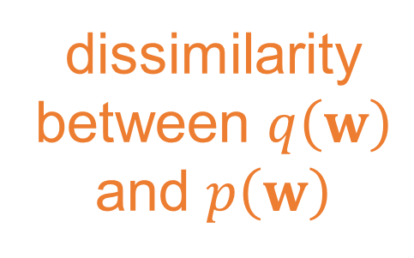

dissimilarity between $q\left(w\right)$ and $p\left(w\right)$
expected
log likelihood
$$ℒ\left(y | x\right)={\left\langle \sum_{i=1}^{n}{{\left(y_{i}−g\left(x_{i};w\right)\right)}^{2}}\right\rangle }_{q\left(w\right)}−KL\left(q\left(w\right)|p(w)\right)+const$$
$$ℒ\left(y | x\right)={\left\langle \log{p\left(y | w,x\right)}\right\rangle }_{q\left(w\right)}−KL\left(q\left(w\right)|p(w)\right)$$

Slide 22
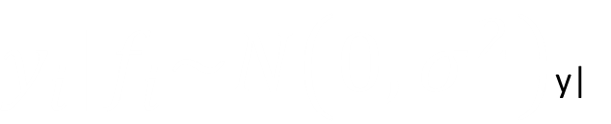

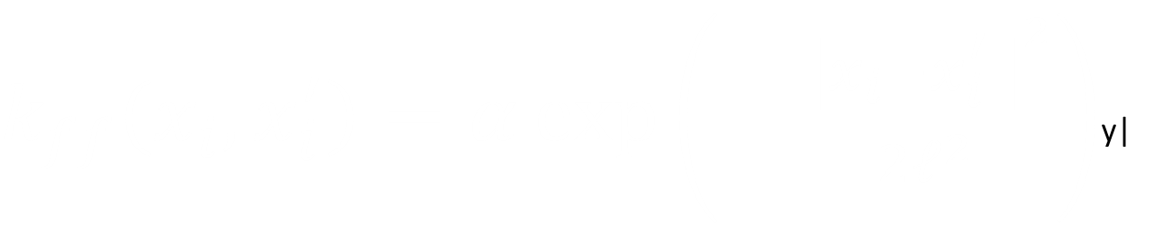
$$f|x\sim N\left(0, K_{ff}\right)$$
$k_{ff}\left(x_{i}, x_{i}^{′}\right)=α\exp\left(−\frac{{\left\|x_{i}−x_{i}^{′}\right\|}^{2}}{2ℓ^{2}}\right)$y|
$y_{i}|f_{i}\sim N\left(0, σ^{2}\right)$y|

Slide 23



$$x$$
$$p\left(y,f | x\right)=p\left(y | f\right)p\left(f | x\right)$$
f
y
$$p\left(y|x\right)=∫p\left(y | f\right)p\left(f | x\right)df$$

Slide 24


$$x$$
$$p\left(y,f,u\right)=p\left(y | f\right)p\left(u | f\right)p\left(f|x\right)$$
$$p\left(y,f,u\right)=p\left(y | f\right)p\left(f | u,x\right)p\left(u\right)$$
$$x$$
u
f
y
u
$p\left(y|u,x\right)p(u)=∫p\left(y | f\right)p\left(f | u,x\right)dfp(u)$

Slide 25


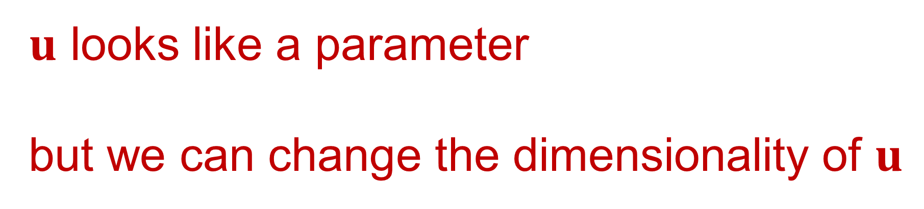
$$p\left(y,u | x\right)=p\left(y | u,x\right)p\left(u\right)$$
$$x$$
u
y
$u$ looks like a parameter
but we can change the dimensionality of $u$
$$p\left(y|x\right)=∫p\left(y | u,x\right)p(u)du$$

Slide 26

two Gaussian processes: apply bound recursively
$$∫p\left(y | f_{5}\right)p\left(f_{5} | f_{4}\right)p\left(f_{4} | f_{3}\right)p\left(f_{3} | f_{2}\right)p\left(f_{1} | x\right)df$$
$$∫p\left(y | f_{5}\right)p\left(f_{5} | f_{4}\right)p\left(f_{4} | f_{3}\right)p\left(f_{3} | f_{2}\right)p\left(f_{1} | x\right)df$$
$\text{g}\left(x\right)={\text{f}}_{5}\left({\text{f}}_{4}\left({\text{f}}_{3}\left({\text{f}}_{2}\left({\text{f}}_{1}\left(x\right)\right)\right)\right)\right)$

Slide 27
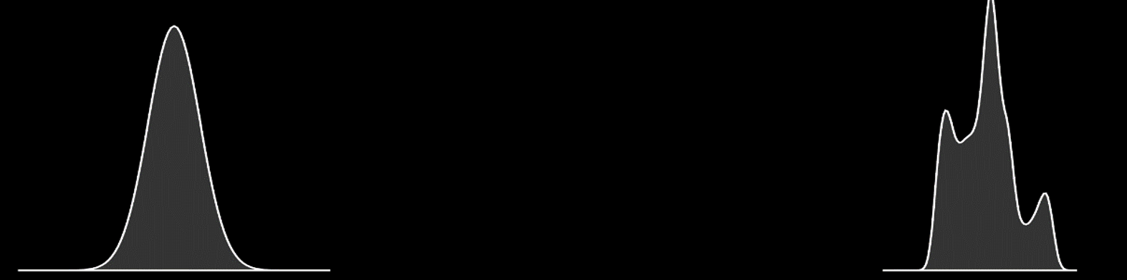
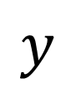
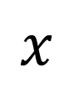

Render Gaussian Non Gaussian
$$y=f(x)$$
$$x$$
$$y$$
Notes:
In practice, many things are non gaussian, here I’ll introduce the idea of process composition: deep Gaussian processes, which we intend to use to deal with the Non Gaussian and abstract nature of the data. I’ll relate it to the OSI model and suggest that abstraction in this way, with propagation of uncertainty is a promising approach to phenomological modelling at multiple levels.

Slide 28

Stochastic Process Composition
A new approach to forming stochastic processes
Mathematical composition:
$$g\left(x\right)=f_{1}\left(f_{2}\left(f_{3}\left(x\right)\right)\right)$$
Properties of resulting process highly non-Gaussian
Allows for hierarchical structured form of model.
Notes:
Non Gaussianity and structure achieved through the process of stochastic process composition. Leads to more flexible familiies of processes which can express more interesting beliefs about the system. Can be made to closely reflect the abstraction structure we referred to before.

Slide 29
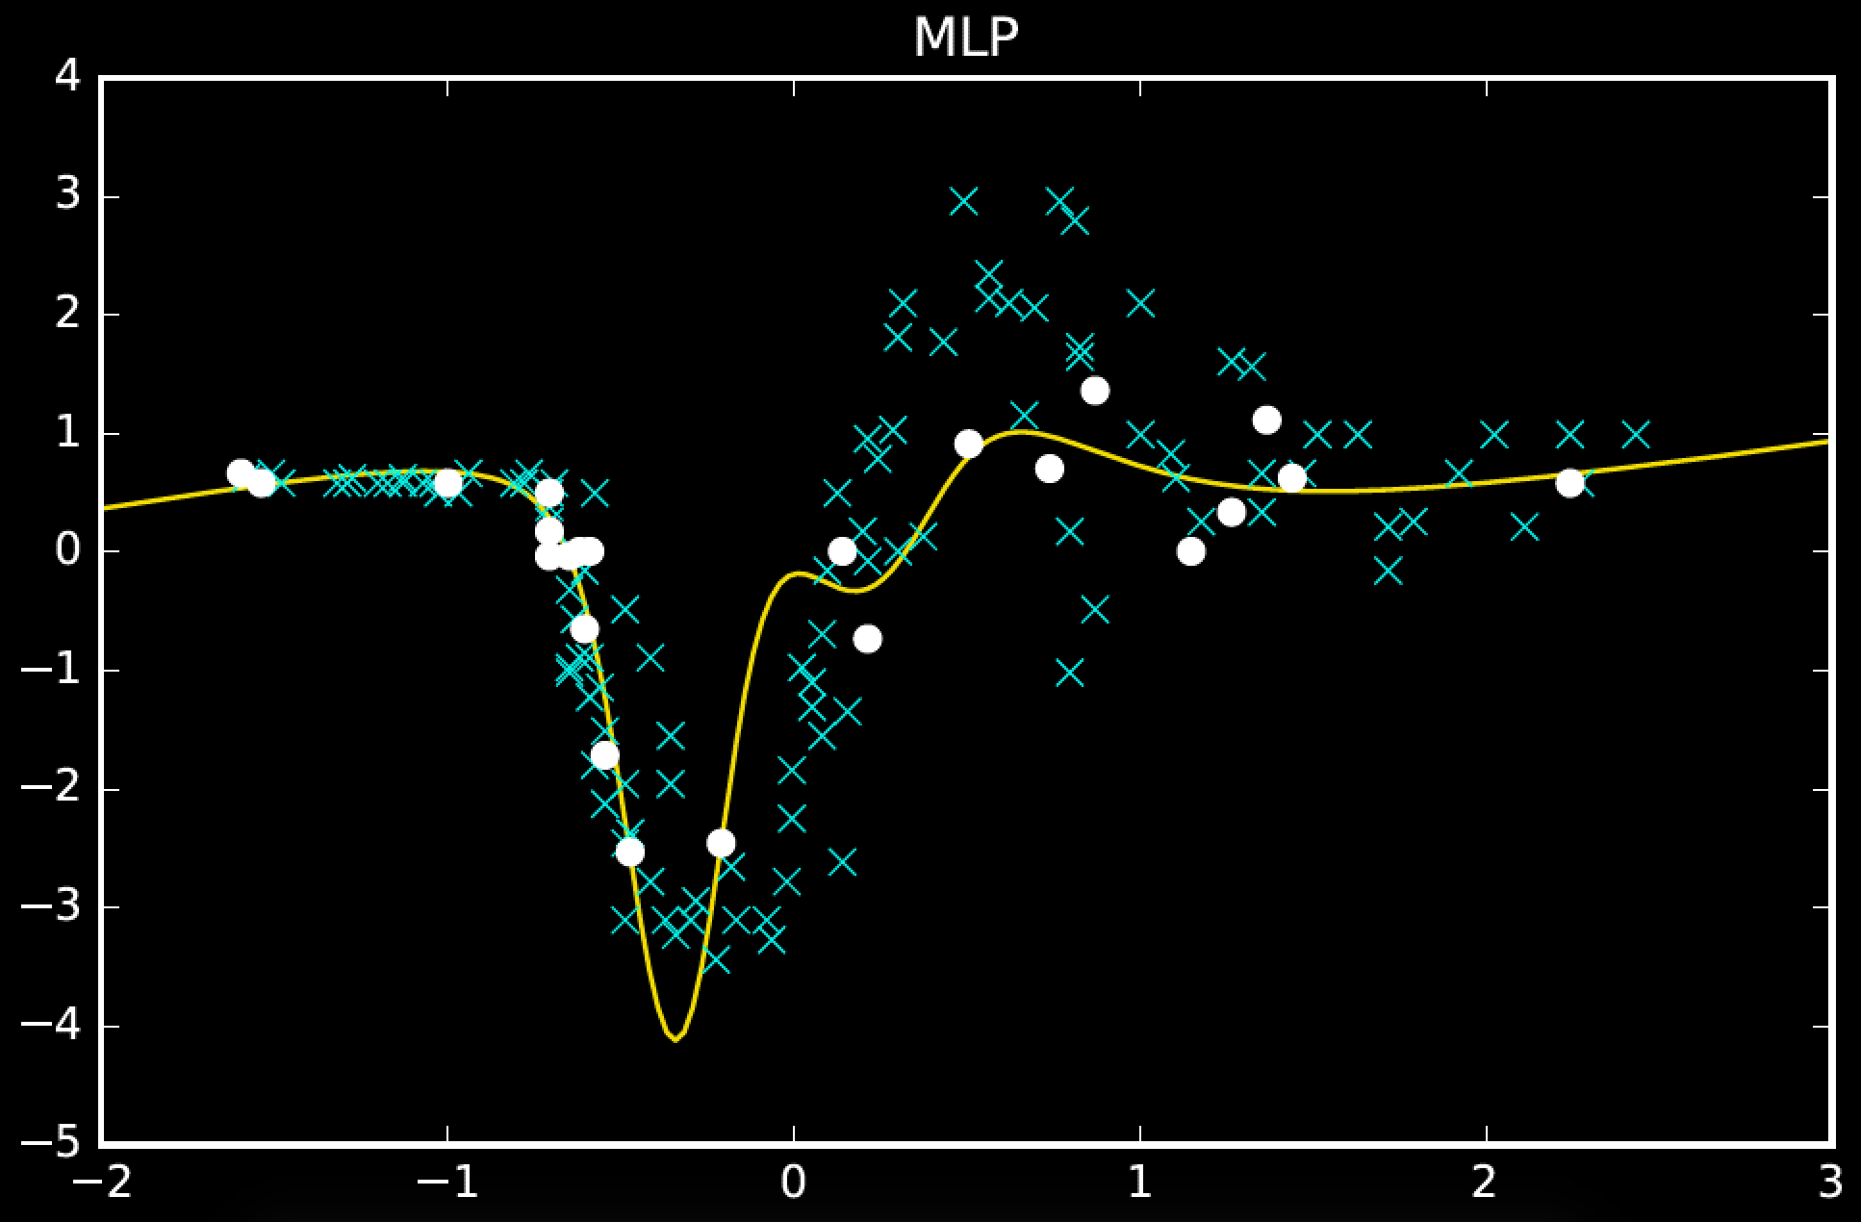
(200 iterations)

Slide 30
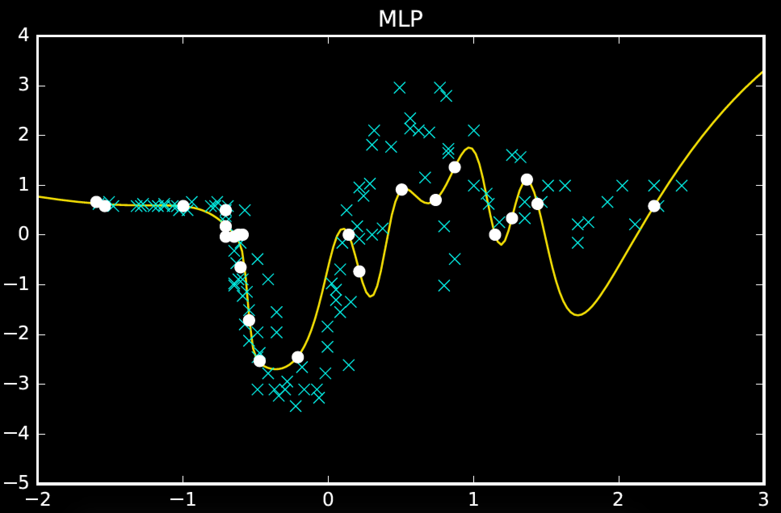
(converged)

Slide 31
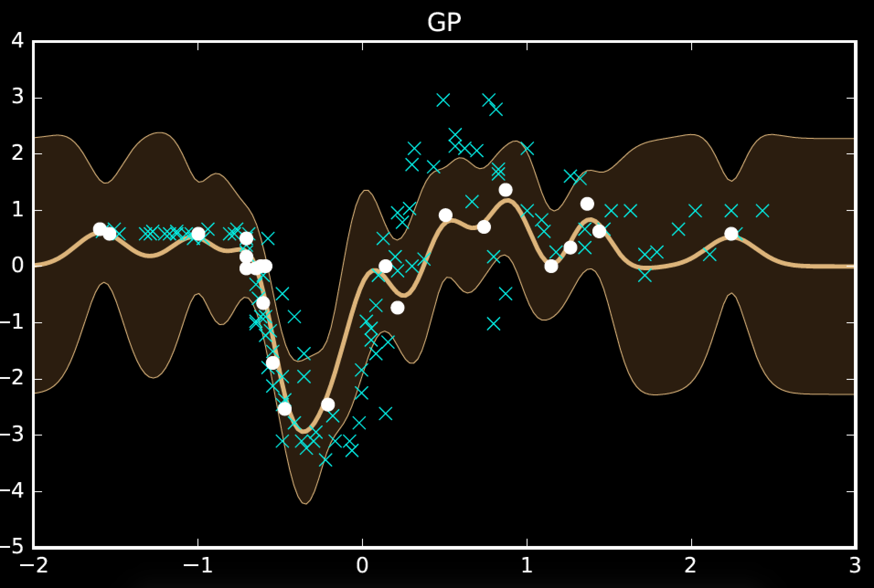

Slide 32
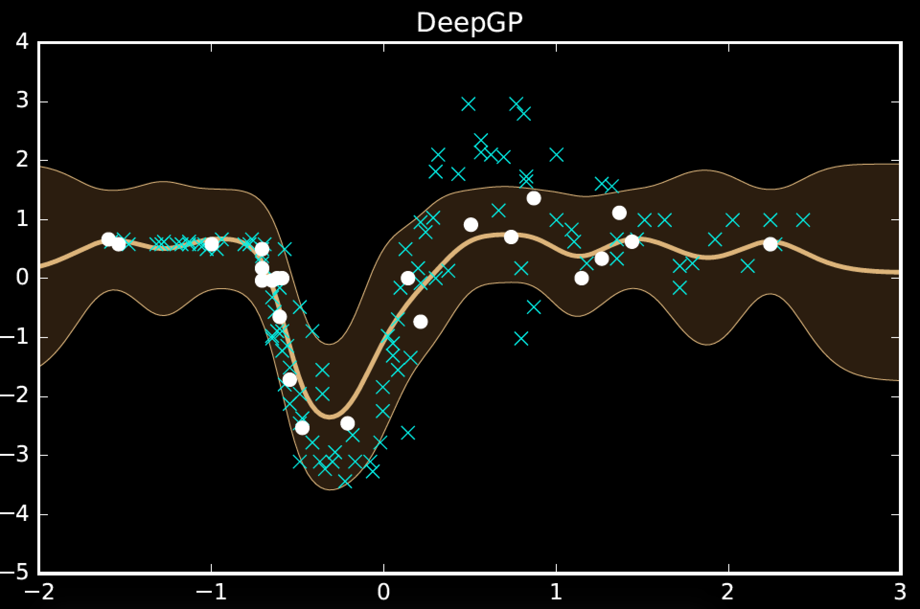
2

Slide 33
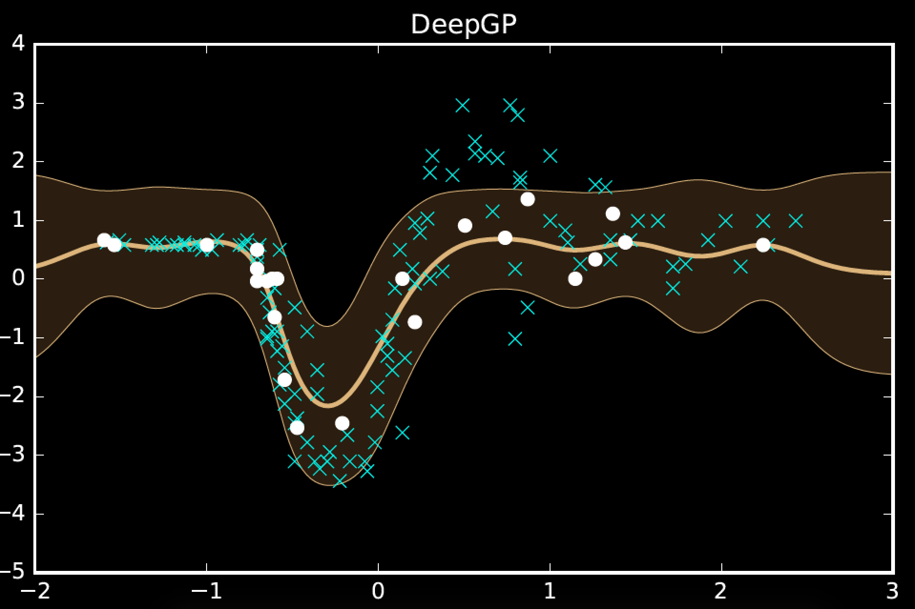
3

Slide 34
model | MSE (train) | MSE (test)
mlp (200 iters) | 108.5 | 1185.1
mlp (converged) | 24.0 | 1338.2
gp | 59.2 | 1095.4
deep gp (2) | 146.2 | 833.7
deep gp (3) | 182.5 | 843.6
One hundred hidden nodes, one hundred inducing points

Slide 35
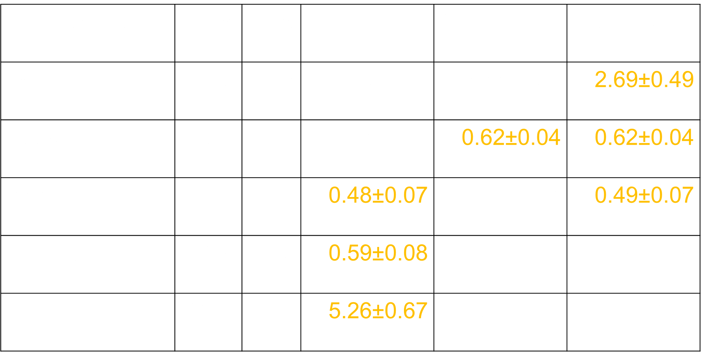
Regression
data set | $$n$$ | $$p$$ | GP | Sparse GP | Deep GP
housing | 506 | 13 | 2.78±0.54 | 2.77±0.60 | 2.69±0.49
redwine | 588 | 11 | 0.72±0.06 | 0.62±0.04 | 0.62±0.04
energy1 | 768 | 8 | 0.48±0.07 | 0.50±0.07 | 0.49±0.07
energy2 | 768 | 8 | 0.59±0.08 | 1.66±0.21 | 1.39±0.49
concrete | 1030 | 8 | 5.26±0.67 | 5.81±0.62 | 5.66±0.62

Slide 36


Classical Latent Variables
$$\text{x}$$
$$\text{y}$$

Slide 37



Classical Treatment
Assume a priori that
Relate linearly to $\text{y}$
Framework covers many classical models PCA, Factor Analysis, ICA
$$x\sim N\left(0,I\right)$$
$$\text{y}\text{= }\text{Wx}\text{ + }ϵ$$

Slide 38


Classical Treatment
Assume a priori that
Relate to $\text{y}$ using neural net
Optimise over $\text{u}\text{, }\text{V}$
$$x\sim N\left(0,I\right)$$
$$y=f\left(x;u,V\right)+ε$$
David applied importance sampling

Slide 39
MATLAB Demo
demo_2016_05_03_iclr.m

Slide 40



New Treatment
Assume a priori that
Relate to $\text{y}$ using neural net
Optimise over $\text{x}$
$$f\left(x\right)\sim N\left(0,K\right)$$
$$y=f\left(x\right)+ε$$
Originally inspired by density nets

Slide 41
MATLAB Demo
demo_2016_05_03_iclr.m

Slide 42
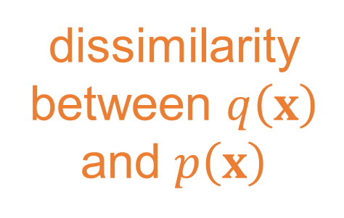

dissimilarity between $q\left(x\right)$ and $p\left(x\right)$
expected
log likelihood
$$ℒ\left(y | u\right)={\left\langle \log{\hat{p}\left(y | u,x\right)}\right\rangle }_{q\left(x\right)}−KL\left(q\left(x\right)|p(x)\right)$$
model remains linear in $u$

Slide 43




$$\hat{p}\left(y | u,x\right)=N\left(y | m, σ^{2}I\right)\exp\left(\frac{c_{ii}}{2σ^{2}}\right)$$
$$p\left(y | u,x\right)≥N\left(y | m, σ^{2}I\right)\exp\left(\frac{c_{ii}}{2σ^{2}}\right)$$
$c_{ii}=k_{ii}(x_{i},x_{i})−k_{iu}(x_{i})K_{uu}^{−1}k_{ui}$ $(x_{i})$
$$m\left(x\right)=K_{fu}\left(x\right)K_{uu}^{−1}u$$
model is not linear in $x$

Slide 44



$${\left\langle k_{ii}\left(x_{i},x_{i}\right)\right\rangle }_{q\left(x_{i}\right)}$$
$${\left\langle K_{fu}\left(x\right)\right\rangle }_{q\left(x\right)}$$
$${\left\langle {K_{uf}\left(x\right)K}_{fu}\left(x\right)\right\rangle }_{q\left(x\right)}$$

Slide 45
Use Abstraction for Complex Systems
High Level Ideas
Stratification of Concepts
Low Level Mechanisms
Notes:
In this slide I’m going to use the layered model of network systems to describe the challenges of understanding complex systems in the physical world such as biological systems and neuroscience. I’ll give an analogy: imagine trying to understand the internet when you only have measurements of the cables and access to YouTube.

Slide 46
Example: Motion Capture Modelling
Notes:
I’ll give a quick demonstration of the deep Gaussian process (or show a video) probably on the motion capture. This one involves walkers and runners.

Slide 47
MATLAB Demo
demo_2016_05_03_iclr.m

Slide 48
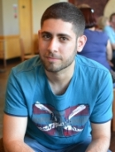
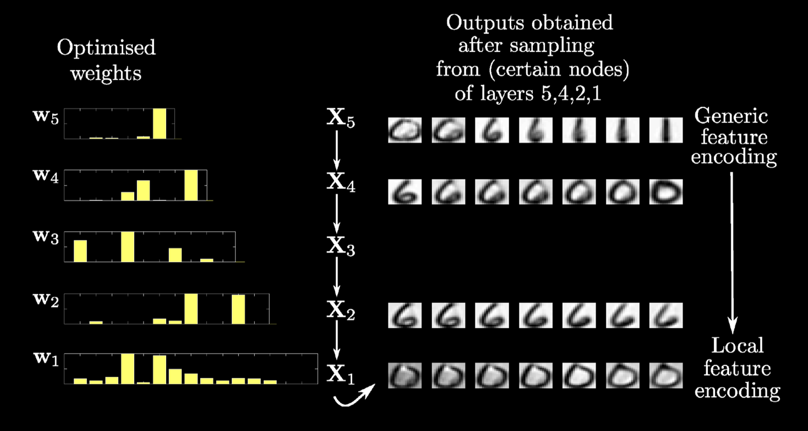
Modelling Digits
Notes:
This one involves a structure that is learnt to model digits.

Slide 49
MATLAB Demo
demo_2016_05_03_iclr.m

Slide 50


Slide 51
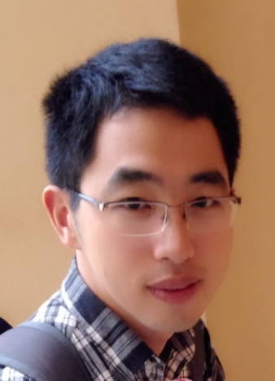
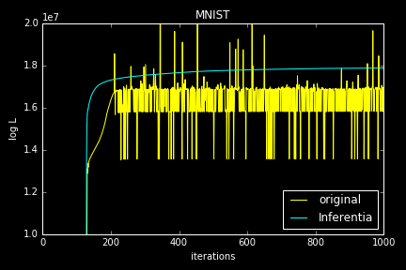
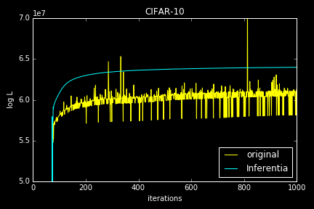
Numerical Issues

Slide 52


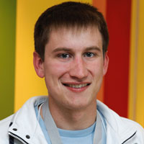
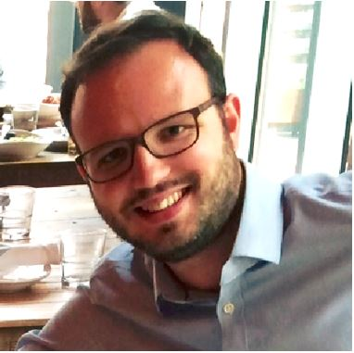
Health
Complex system
Scarce data
Different modalities
Poor understanding of mechanism
Large scale
genotype
environment
epigenotype
State of health
clinical tests
gene expression
Organ states
treatment
clinical notes
Cell states
survival analysis
PLoS Comp Bio, Nature Communications
biopsy
X-ray
biopsy
X-ray

Slide 53
To Find Out More
Gaussian Process Summer School
12th-15th September 2016 in Sheffield http://gpss.cc/
Posters at ICLR:
Recurrent Gaussian Processes
Variationally Auto-Encoded Deep Gaussian Processes
Python software for GPs (GPy)
https://github.com/SheffieldML/GPy/
David’s “Gaussian Process Basics” talk

Slide 54
Thank you
Neil Lawrence
http://inverseprobability.com
@lawrennd
Notes:
Thank you.

